Slide 1
RA Tutorial

Slide 2
TIPS & TRICKS FOR
RELATIONAL ALGEBRA QUERIES

Slide 3
Evaluating R.A. Queries
R.A. is procedural
  an R.A. query itself suggests a procedure for constructing the result (i.e., how to implement the query)
R.A. suggests a query execution plan
  Two RA expressions might yield the same result
  but suggest different query execution plans
  which is best depends on the relation cardinality,
  defined indices, join ordering, etc.
DBMSs: query optimization takes place
  Optimizer rewrites queries to be more efficient
  topic in csc443
π
σ
Execution flow
R
S
Notes:
QU: Thinking of the operations, can you suggest any principles?
If equivalent, always better to project first rather than later.
Always better to defer join or Cartesian product

Slide 4

Tips and Tricks for R.A.
Ask yourself which relations need to be involved?
  Ignore the rest
Every time you combine relations confirm that:
  (a) attributes that should match will be made to match
  (b) attributes that will be made to match should match

Slide 5
Tips and Tricks for R.A. (cont.)
Is there an intermediate relation that
would help you get the final answer?
  Draw it out with actual data in it
Break the answer down by defining intermediate relations using assignment:
  Use good names for the new relations
  Name the attributes on the Left-Hand-Side each time, so you don’t forget what you have in hand
  Add a comment that explains exactly what the relation contains

Slide 6
Tips for Specific R.A. Queries
To show “max” (min is analogous):
  Pair tuples (self-join) and find those that are not the max
  Then substract from all to find the max[es]
To show “k or more”:
  Make all combos of k different tuples that meet the required condition
To show “exactly k”:
  Find “k or more”
  Find “(k+1) or more”
  Then subtract “(k+1) or more” from “k or more”
To show “every” (i.e., division):
  Make all combos that could have occurred
  Subtract those that did occur to find those that didn’t always; these are the failures
  Subtract the failures from all to get the answer

Slide 7
WORKING EXAMPLES
(SET-SEMANTICS)

Slide 8
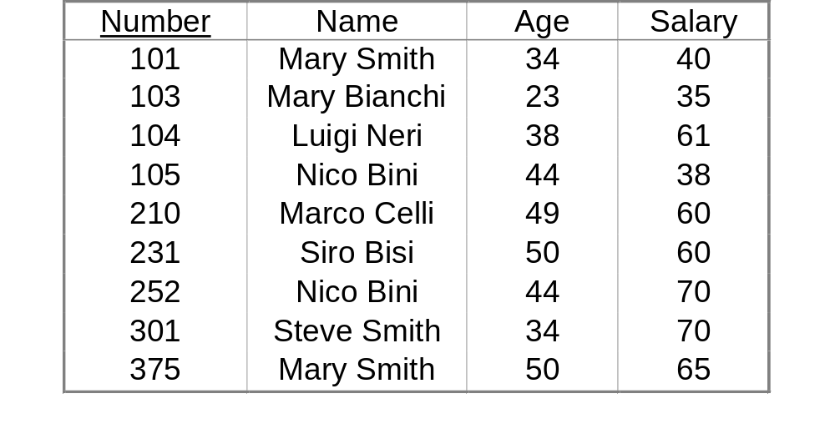
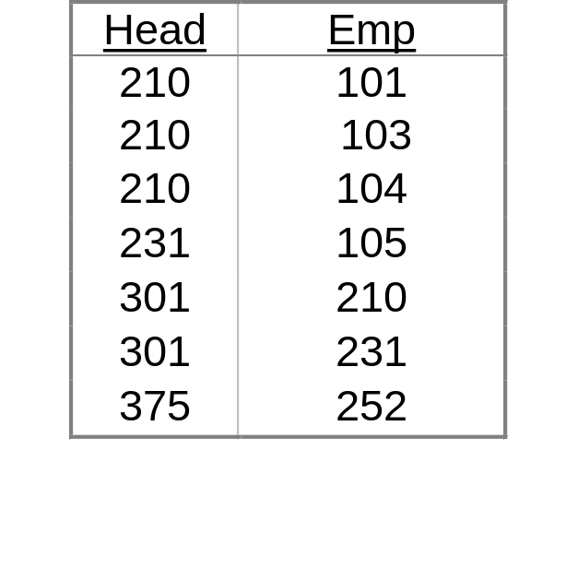
A Sample Database
Employees
Supervision
    In fact, only the database schema and integrity constraints are needed:
    Employees(Number,Name,Age,Salary)
    Supervision(Head,Emp)
    π_{Head}(Supervision) ⊆ π_{Number}(Employees)
    π_{Emp}(Supervision) ⊆ π_{Number}(Employees)
Notes:
We omit the key constraints for brevity

Slide 9
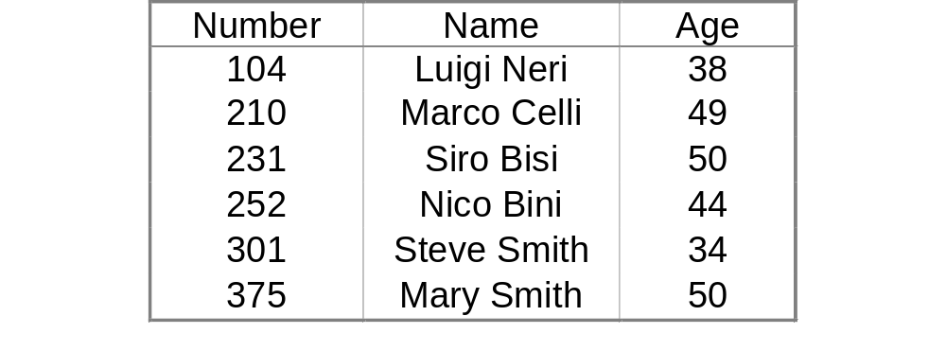
Example 1
“Find the numbers, names and ages of employees earning more than 40K”
    Employees(Number,Name,Age,Salary)
    Supervision(Head,Emp)
π_{Number,Name,Age}(σ_{Salary>40}Employees)

Slide 10
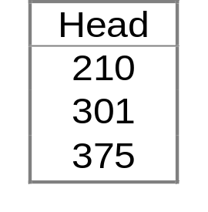
Example 2
“Find the registration numbers of the supervisors of the employees earning more than 40K.”
    Employees(Number,Name,Age,Salary)
    Supervision(Head,Emp)
π_{Head}(Supervision ⋈_{Emp=Number}(σ_{Salary>40}Employees))
  R(Head,Emp,Number,Name,Age,Salary))

Slide 11

Example 3
“Find the names and salaries of the supervisors of the employees earning more than 40K.”
    Employees(Number,Name,Age,Salary)
    Supervision(Head,Emp)
π_{NameH,SalH}(ρNumber,Name,Salary,Age→NumH,NameH,SalH,AgeHEmployees
⋈_{NumH=Head} (Supervision ⋈_{Number=Emp}(σ_{Salary>40}Employees))))
R(NumH,NameH,AgeH,SalH,Head,Emp,Number,Name,Age,Salary)

Slide 12
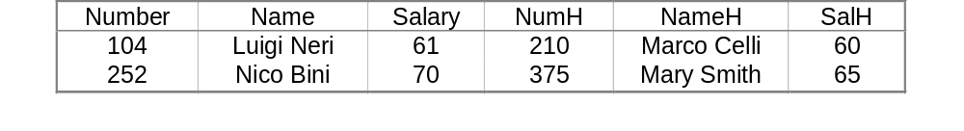
Example 4
“Find the employees earning more than their respective supervisors; return registration numbers, names and salaries of the employees and their supervisors.”
    Employees(Number,Name,Age,Salary)
    Supervision(Head,Emp)
πNumber,Name,Salary,NumH,Nam3H, SalH
(σ_{Salary>SalH}(ρNumber,Name,Salary,Age→NumH,NameH,SalH,AgeHEmployees ⋈_{NumH=Head} (Supervision ⋈_{Emp=Number} Employees)))
R(NumH,NameH,AgeH,SalH,Head,Emp,Number,Name,Age,Salary)

Slide 13
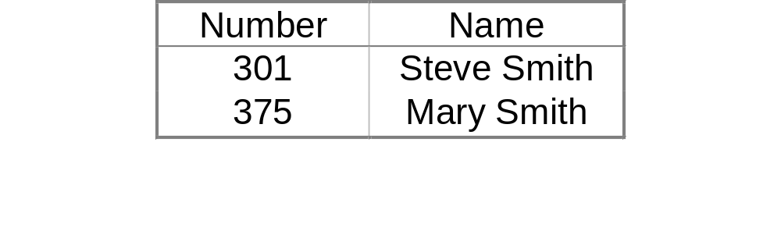
Example 5
“Find registration numbers and names of supervisors, all of whose employees earn more than 40K.”
    Employees(Number,Name,Age,Salary)
    Supervision(Head,Emp)
π_{Number,Name}(Employees ⋈_{Number=Head} (π_{Head} (Supervision) -
π_{Head} (Supervision ⋈_{Number=Emp} (σ_{Salary≤40}Employees))))

Slide 14
Example 6
“Find registration numbers of supervisors, who supervise all employees earning more than 40K.”
    Employees(Number,Name,Age,Salary)
    Supervision(Head,Emp)
π_{Number} (Supervision / π_{Number}(σ_{Salary>40}Employees))
Solution without using division
All_40KEmp_Head(Head, Emp):= π_{Numbe.r, Head} (Supervision X π_{Number}(σ_{Salary>40}Employees))
Not_All_Emp(Head):=π_{Head} (All_40KEmp_Head - Supervision)
Answer(Head):= π_{Head} Supervision - Not_All_Emp

Slide 15

Example 7
“Find the employees earning maximum salary.”
    Employees(Number,Name,Age,Salary)
    Supervision(Head,Emp)
A = π_{Salary}(Emp) - π_{Salary}(σ _{Salary1>Salary}(Emp X ρ_{everything}(Emp))
A provides the maximum salary; the rest is easy …
π_{Number}(Emp ⋈ A)
How to find minimum salary?
How to find average salary?
Notes:
Furthermore, computing various functions on a column, like the summing up its elements, is also not possible using the relational algebra introduced so far. There are five aggregate functions that are included with most relational database systems. These operations are Sum, Count, Average, Maximum and Minimum.
Salary1 Salary
50 35
60 50
70 65
35
50
65
35
50
65
70

Slide 16
Example 8
"Find all locations that have at least two employees earning more than 40K"
    Employees(Number,Name,Loc,Salary)
    Supervision(Head,Emp)
Assume that in the schema we have ‘Loc’
instead of ‘Age’ for this example only.
σ _{salary>40}(Emp) ⋈ σ _{salary1>40}(ρNumber,Name,Salary→Num1,Name1,Sal1Emp)
This results in a relation
R(Number, Name, Salary, Loc, Num1, Name1, Sal1)
Now we select tuples where Number≠Num1 and project on Loc
π_{Loc}(σ _{Number≠Num1}R)
How to find locations that have at least three employees …?
How to find locations that have exactly two employees …?
Notes:
Natural Join on Loc

Slide 17
Another Series of Examples
  Films(Film#, Title, Director, Year, ProdCost)
  Artists(Actor#, Surname, FirstName, Sex, Birthday, Nationality)
  Roles(Film#, Actor#, Character)

Slide 18
Example 1
  Films(Film#, Title, Director, Year, ProdCost)
  Artists(Actor#, Surname, FirstName, Sex, Birthday, Nationality)
  Roles(Film#, Actor#, Character)
“Find the titles of films starring Henry Fonda"
π_{Title}(Films ⋈ (σ(FirstName=“Henry”) ∧ (Surname=“Fonda”)(Artists ⋈ Roles)))

Slide 19
Example 2
  Films(Film#, Title, Director, Year, ProdCost)
  Artists(Actor#, Surname, FirstName, Sex, Birthday, Nationality)
  Roles(Film#, Actor#, Character)
“Find the titles of all films in which the director is also an actor”
π_{Title}(σ_{(Director=Actor#)}(Films ⋈ Roles))

Slide 20
Example 3
  Films(Film#, Title, Director, Year, ProdCost)
  Artists(Actor#, Surname, FirstName, Sex, Birthday, Nationality)
  Roles(Film#, Actor#, Character)
“Find the actors who have played two characters in the same film; show the title of each such film, first name and surname of the actor and the two characters”
  πTitle,FirstName,Surname,Character1,Character
  (ρFilm#,Actor#,Character→Film#1,Actor#1,Character1(Roles)
  ⋈(Film#1=Film#)∧(Actor#1=Actor#)∧ (Character1≠Character)
  Roles ⋈ Artists ⋈ Films)

Slide 21
Example 4
  Films(Film#, Title, Director, Year, ProdCost)
  Artists(Actor#, Surname, FirstName, Sex, Birthday, Nationality)
  Roles(Film#, Actor#, Character)
“Find the titles of the films in which the actors are all of the same sex”

π_{Title}(Films) –
π_{Title}(Films ⋈ σ _{sex≠sex1 ∧Film#1 = Film#}((Artists ⋈
Roles) ⋈ρ _{Ac#,Char,Sur,Fir,Sex,BD,N}
→Ac#1,Char1,Sur1,Fir1,Sex1,BD1,N1(Artists ⋈ Roles))
Notes:
First, get the titles of films in which there are at least two actors of different sex
Then, deduct from all titles the titles found in the intermediate step.

